Slide 1
When Infrastructure Fails…
Urban Infrastructure 6
Notes:
Change in lecture; conflate all the themes under the banner of planning and infrastructure

Slide 2
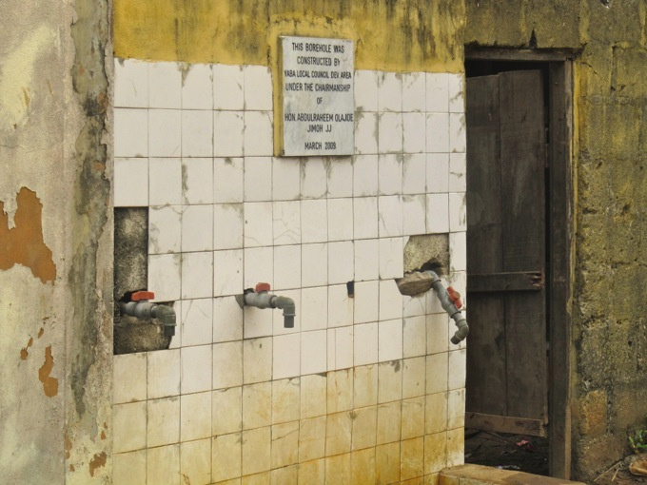
‘…because they rely on the continuous agency of infrastructure to eat, wash, heat, cook, light, work, travel, communicate, and remove dangerous or poisonous wastes from their living place, urbanites often have few or no real alternatives when the complex infrastructures that sometime manage to achieve this are removed or disrupted’
(Graham, 2010)

Slide 3
Really?

Slide 4
Today
Lagos
When infrastructure fails
Core ideas
Global South
Video
Questions
Video
Readings
Discussion
Lagos
Notes:
This is Lagos; not welcome to Lagos

Slide 5
Material Consequences
Through technological agency; the material elements of infrastructure transform natural into cultural, social and urban; what agency emerges when infrastructure fails?
Continued belief in the ‘magic’ of infrastructure
Infrastructure as precarious achievement requiring constant effort to maintain functioning

Slide 6
Video…
Bus Rapid Transit
Clean and Green

Slide 7
The ‘Domino’ effect
Multiple infrastructure systems tend to intimately rely on one another in producing the broader circulations and metabolisms of the city (Graham, 2004)
Infrastructure evolve and relate together
E.g. infrastructure and cyber technology; water and sanitation
Cascading effect; when one fails it may have unintended consequences for others

Slide 8
Agency
Interrupted supply and flow make the invisible visible
“the normally invisible quality of working infrastructure becomes visible when it breaks: the server is down, the bridge washes out, there is a power black-out” (Bowker and Star, 2000)
Notion of the value-free employed to the public good in question
Opportunities to rethink urban life

Slide 9
Improvised Access and Innovation
Innovation in the face of need
Mobility and livelihoods
Broadening of the range of actors in the infrastructural terrain
Social networks and survival
Kinship relations and ongoing negotiation
‘Collective improvisation’
What does this say about urbanity?

Slide 10
Video…
Witness: Street Life in Lagos

Slide 11
Spatial Impacts
Fragmentation and splintering
Fortification
Infrastructure as the panacea and new exclusions that emanate from that
‘New normalities’
(McFarlane, 200)

Slide 12
‘New’ infrastructures and relationships to nature
Conquering nature out of need
Using natural systems in the absence of built systems
Absence of management
Threat of disaster
Harassment and containment

Slide 13
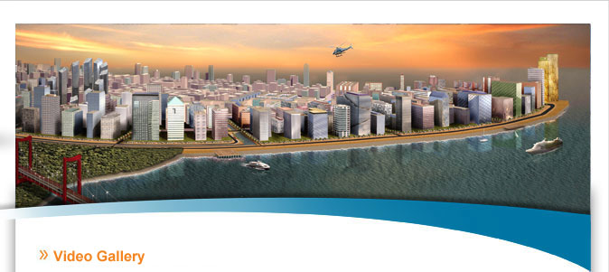
Video…
Eko Atlantic

Slide 14
Questions
Space and Settlement
Material change
Agency
Gandy (2006) argues that the infrastructural crisis in Lagos calls for capacity that falls outside the usual sphere of governance. Do you agree? What does this mean for the built environment professions?
Could initiatives such as the BRT, the greening project and Eko Atlantic contribute to renewal? What are the limits and what are the potentials?
“Infrastructure is government’s responsibility”, notes the Lagos-based architect Koku Konu, “if not to put it in place, then to plan” (Gandy, 2006). Comment on this quote in view of what you have read, seen and heard today.
Infrastructure makes the invisible visible and some would argue, exposes the limits of the state. In fact, Lund (2007) argues; “…many institutions in Africa operate in the twilight between state and society, between public and private, and what characterizes them is their movement in and out of a capacity to exercise public authority.” What do you think this means for infrastructure planning and the ongoing production of space?

