Slide 1
Actors and Agency in Infrastructure…and the role of the Planner
Urban Infrastructure 3
Notes:
Change in lecture; conflate all the themes under the banner of planning and infrastructure

Slide 2
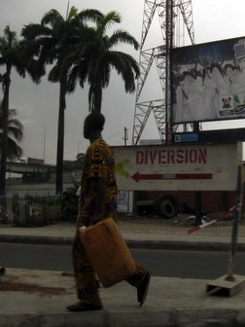
‘By considering the city as an enormous artifact, the size and distribution of its streets, sidewalks, buildings, squares, parks, sewers, and so on can be interpreted as remarkable physical records of the sociotechnical world in which the city was developed and conceived.’
(Aibar and Bijker, 1997)
Notes:
What do I mean by sociotechnical process? How do we intervene in this process as built environment professionals?

Slide 3
Structure
What constrains the current relationship between planning and infrastructure?
How can infrastructure be harnessed to shape cities that are more inclusive and equitable?
How can a planning become a more effective tool for service delivery?
I. Infrastructure in Africa
III. Spatial Planning and Infrastructure
V. Re-conceptualizing
infrastructure
IV. Actors and Agency in Infrastructure Delivery
II. Splintering Urbanism

Slide 4
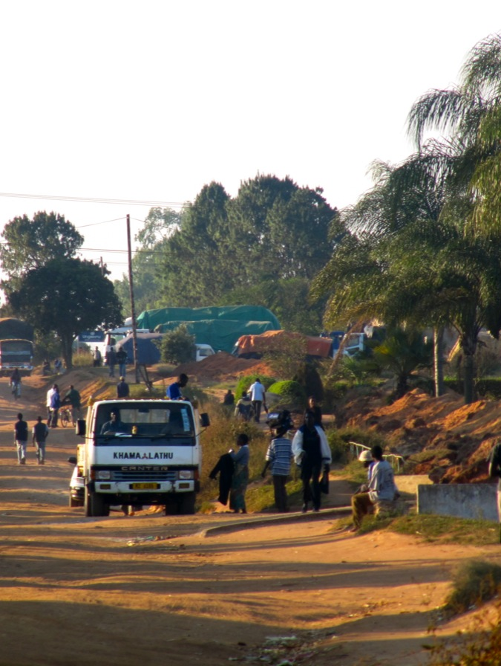
I. Infrastructure in Africa
Declining provision – service levels for piped water and sanitation lower than in 1990s
A drop in public sector spending; investment levels 40 – 50% of what they were 10 – 15 years ago
(Estache, 2004)
Supply not keeping up with demand, due to
  High growth in urban areas (3.6% p.a.)
  Decreasing household size
  Cost restrictions to access
  (Banerjee et al, 2008)
Most underserviced region – more than other developing regions such as Latin America and South Asia
Paved roads, landlines and power are the lagging sectors
Telecommunications the exception – leapfrog phenomenon
Notes:
Second bullet point; not due to greater efficiency!

Slide 5
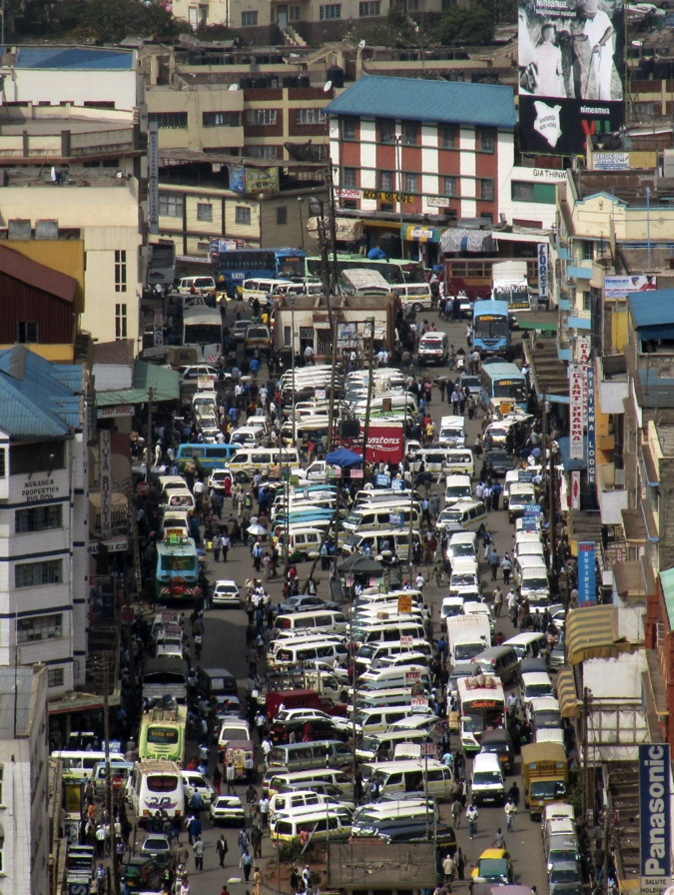
I. Infrastructure in Africa
Spatial Dimensions
Difficult regional geographies: landlocked countries, topography, uneasy politics which makes regional cooperation difficult
Difficult economic geographies
Road transport used to move 90% of freight and passengers; feeder road system grossly insufficient
(Cilliers et al, 2011)
70 – 90 % urban pop in proximity to piped water and electricity but coverage rates between 20 – 40 % less than that
20% of urbanites live more than 1 km from their water source
(Banerjee et al, 2008)
Infrastructure and economic growth: the locational logic of firms is determined through economies of scale and transportation infrastructure
(Estache, 2004)
Notes:
NEPAD
Two dimensions to the first point; and it is a very important point;
One; if you build it they won’t necessarily come; two, costs of network expansion will not necessarily be offset by ongoing payment – not as many people will connect
THUS; demand management is necessary and small customer base to cover costs
So cost recovery and privatisation are not really options on a broad scale

Slide 6
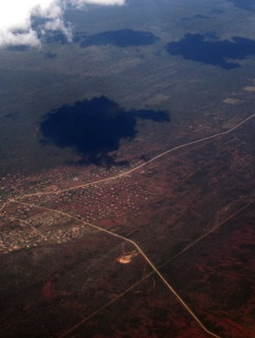
II. Splintering Urbanism
Planning and the Modern Infrastructural Ideal
Modern Urbanism as a socio-technical process
Splintering Urbanism

Slide 7
II. Splintering Urbanism
Ideologies of science, technology and the city
Modern urban planning
Economic relations mediated by utilities and transport
The role of the state
The four pillars of the modern infrastructural ideal
“Infrastructural networks, now widely seen through organic metaphors as the very ‘connective’ tissue, ‘nervous systems’ or ‘circulation systems’ of the nation….
Became an essential focus of the power, legitimacy and territorial definition of the modern nation state”
(Graham and Marvin, 2001: page no)

Slide 8
II. Splintering Urbanism
Ideologies of science, technology and the city
Modern urban planning
Economic relations mediated by utilities and transport
The role of the state
The parameters have shifted
Liberalisation and privatisation
The State is not delivering
Infrastructure failure
Resource constraints
Engaging hybrid institutional forms
Project-based implementation with little overall coordination

Slide 9
II. Splintering Urbanism
Ideologies of science, technology and the city
Modern urban planning
Economic relations mediated by utilities and transport
The role of the state
Infrastructure and the locational decisions of firms
Post-fordism
The Network Society
Investment patterns influenced by infrastructural packages that differ from the past
Economic restructuring

Slide 10
II. Splintering Urbanism
Ideologies of science, technology and the city
Modern urban planning
Economic relations mediated by utilities and transport
The role of the state
The continuous reinvention of planning
Moving on from Modernism
Strategic spatial planning
Bridging the gap between planning and implementation
Ongoing questioning of the efficacy of planning
Collaborative planning decision making – relational processes
Understanding power

Slide 11
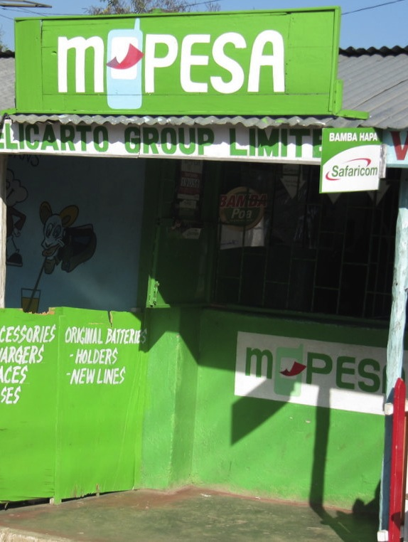
II. Splintering Urbanism
Critique of Splintering Urbanism
Oversimplification
Using infrastructure to re-integrate the city
Colonial histories – the modern infrastructural ideal never existed
Apartheid – the modern infrastructural ideal used to segregate
Sylvie Jaglin’s research on electricity in Cape Town – demand management through more heterogeneous range of actors
Split institutional agendas?

Slide 12
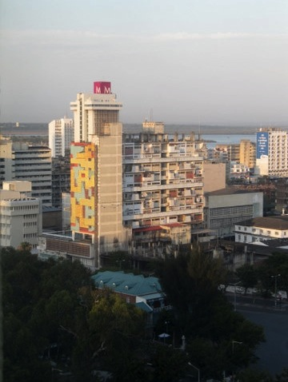
III. Spatial Planning and Infrastructure
An opportunity to reshape cities?
Policy emphasis on large scale infrastructure delivery as key to growth (Australia), employment (South Africa) and urban regeneration (Lagos State)
‘the city as a constellate infrastructure giga-project’ (Dodson, 2009: 110)
Opportunity to engage communities of interest in pursuing shared values and broader benefits (Marvin and Guy, 1997)

Slide 13
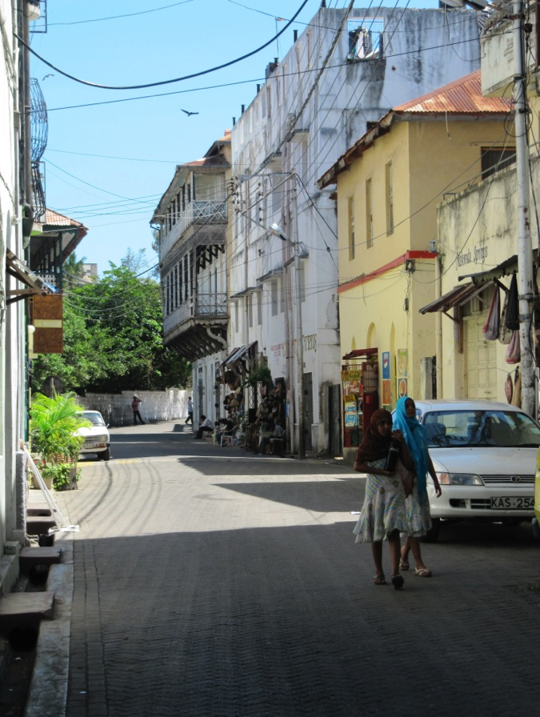
III. Spatial Planning and Infrastructure
Implications
Gap between planning and infrastructure delivery has widened
Planners often do not have the institutional power and sufficient networks to negotiate with service providers (Baker and Hincks, 2008)
Wider gap between spatial visions and actual delivery
Technical intervention is not enough
Negotiating multiple interests and establishing a frame for negotiation; short term gains versus long term aims
Need alternative, innovative approaches

Slide 14

IV. Actors and Agency in Infrastructure Delivery
Delivery mechanisms have shifted
Broadening of the institutional actors involved in service delivery
Beyond privatisation
Hybrid institutional assemblages
Coordinate between service demand, institutional parameters and resource constraints
“Because networks can no longer be simply extended, new questions about the relationship between developers, infrastructure providers and planners are arising.”
(Marvin and Guy, 1997: 2029)

Slide 15
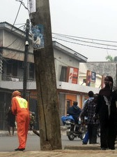
IV. Actors and Agency in Infrastructure Delivery
The emphasis on Decentralisation
Increase in range of actors and vested interests
Notes:
This certainly has its own politics; see Kampala, Lagos

Slide 16

IV. Actors and Agency in Infrastructure Delivery
When infrastructure fails
The need for ‘second-best’ alternatives
(Banerjee et al, 2008)
Actors beyond public and private sectors
Entry point for ‘informal’ providers; but how informal are they?
Clientelism and contingent networks that are tied to age-old political battles (Lagos)
Notes:
Water vendors for example; pay more per liter but people just use less. (Mobile phone providers – case economy) -

Slide 17

IV. Actors and Agency in Infrastructure Delivery
Co-Production and Service Delivery
Institutional alliances that are sometimes unorthodox
At best; diversity, experimentation and multi-actor arrangements
Permeability of the public-private divide
Hybrid, and sometimes temporary, institutional forms
Notes:
Conventions focus on a narrow range of actors

Slide 18
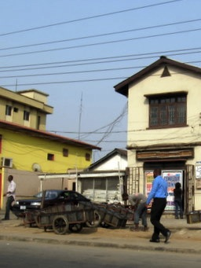
IV. Actors and Agency in Infrastructure Delivery
Intermediaries
Indicative of a more complex governance terrain – network governance
Agencies that work in between service providers, users and regulators and negotiate relations between these groups
Their function defined by their ‘in-betweenness’ (Ibid.); they connect, inform, coordinate
Entry into thinking about governance differently – hybrid management
Can be an individual actor, a network or a programme of work
Intentionality; where boundaries between production and consumption are broken down and reconstituted (Marvin and Medd, 2004)

Slide 19
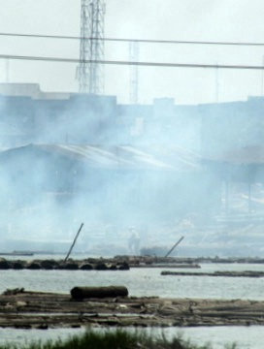
IV. Actors and Agency in Infrastructure Delivery
Negotiation between
Need to move beyond the agency model (Ennis,1997)
The Spatial Plan as the frame?
Principled Negotiation versus Positional Bargaining
Values and agreed upon principles
The Plan as a negotiation framework
Notes:
Water vendors for example; pay more per liter but people just use less. (Mobile phone providers – case economy) -

Slide 20

V.
Re-conceptualizing infrastructure
The role of spatial planning
The process of planning decision making
Spatial literacies

Slide 21
IV.
Re-conceptualizing infrastructure
Infrastructures as Socio-Technical Systems
Structural perspectives; the political economy of service delivery
Technological and Economic Determinism
Conceptual Shifts
Structuralist frame does not provide a descriptive terminology for examining instances of the development process (Healey, 1992: 35)
Infrastructure as ‘connective tissue’ (Tarr and Dupuy, 1988)
Infrastructure as barrier; includes whilst excluding
Infrastructure as neutral backbone

Slide 22
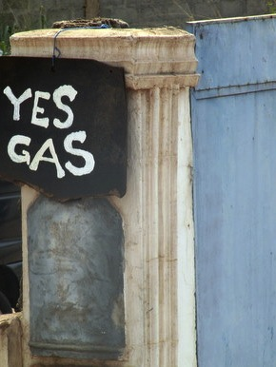
IV.
Re-conceptualizing infrastructure
Infrastructure as Precarious Achievement
The dynamic achievement of a functioning energy, communications, water or transport network requires constant effort to maintain the functioning system
These are socio-technical systems underpinned by institutional relationships informing livelihoods

Slide 23
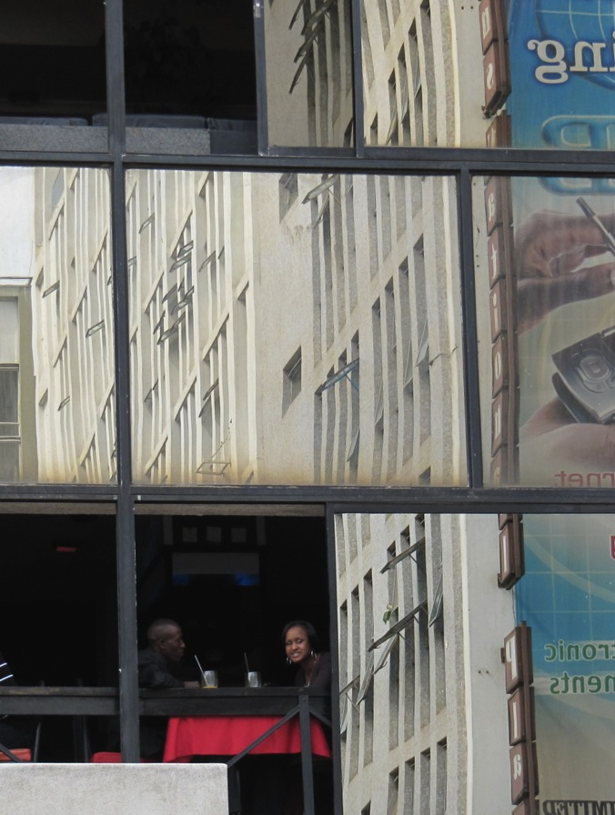
IV.
Re-conceptualizing infrastructure
Infrastructure as Assemblage
Socio-technical networks
Dynamic
Constantly being negotiated
Much more than a collection of technical ‘things’
‘technological networks…are mediators through which the perpetual process of transformation of Nature into City takes place’
(Graham, 2009: page no)

Slide 24
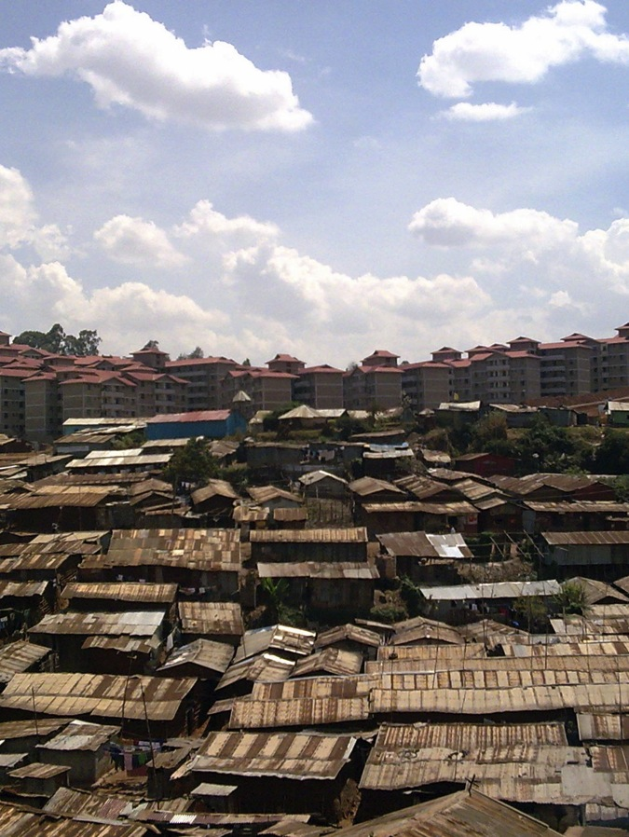
IV.
Re-conceptualizing infrastructure
Political Infrastructures
Who does infrastructure serve?
Who suffers when there is breakdown?
“a key starting point here is that the construction of spaces of mobility and flow for some always involves the construction of barriers for others”
kinetic elites (Urry, date)
Privatisation and liberalisation of infrastructure – hybrid institutional forms

Slide 25
The Questions
What constrains the current relationship between planning and infrastructure?
How can infrastructure be harnessed to shape cities that are more inclusive and equitable?
How can a planning become a more effective tool for service delivery?
Limited understanding of drivers
Understanding the subtleties
of Supply and
Demand Dynamics
Planning processes not
sufficiently inclusive of
all relevant actors
Conventional Supply Logic
Increasingly challenged; shifts
to more demand oriented logic
The Space Economy
of Infrastructure
Notes:
Infrastructure providers based network planning on the assumption that economic growth would continue to stimulate demand; is that true; and what about new demand?
Providers require greater certainty before making investments (private money)
Not just understanding demand but also managing it – environmental demands for example – differentiation between users

